Slide 1
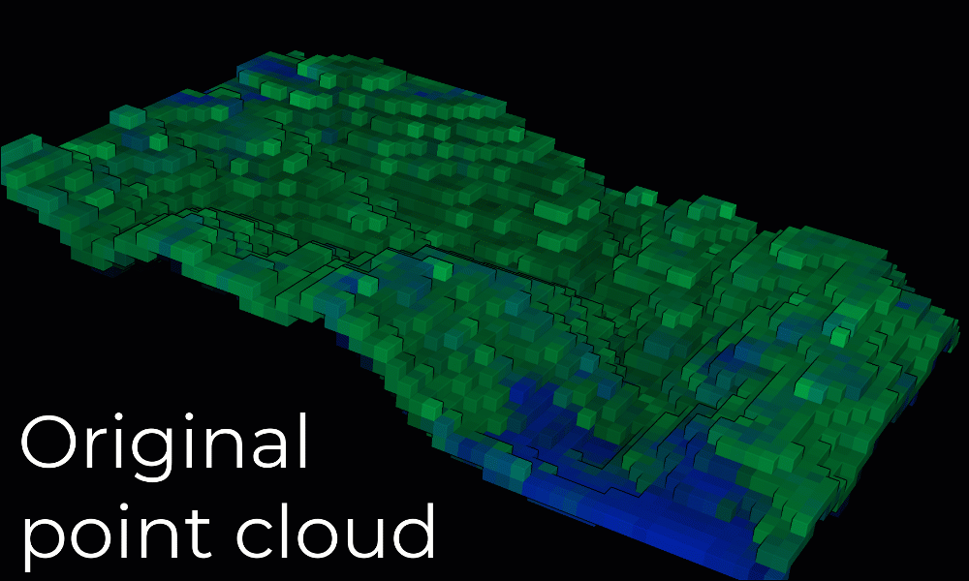
Lidar Point Cloud Processing
Chee Seng (Cheese)
https://towardsdatascience.com/how-to-automate-lidar-point-cloud-processing-with-python-a027454a536c

Slide 2
basics
Geen/ infrared light to track reflection
IMU (internal measurement unit) to track position
Pulse – burst of light
Return – light received
Pulse - return = travel time * speed of light /2
Ground elevation = altitude – distance

Slide 3
Old methods of object detection
Segmentation
Manual feature extraction
Classification
2D raw input data and use convolutional neural network to identify images for classification
Require high semantic content
Lack of spatial information, low accuracy in position estimation
Need big data

Slide 4
Potential implementation
Semantic segmentation through deep learning
Deep feature representation through neural networks
3D input method – point cloud
Rotation / solid-state LiDAR takes intensity of point surrounding vehicle
Spatial rich but need re-arrangement to be processed as 2D
Two main methods,
Apollo FCNN object detection algorithm, https://github.com/ApolloAuto/apollo/blob/master/docs/specs/3d_obstacle_perception.md
geometric based pipeline
Source: https://arxiv.org/pdf/2008.00706.pdf

Slide 5
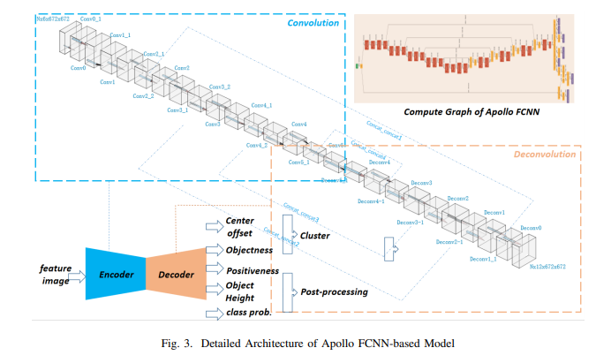
Apollo FCNN-based Model – segmentation of point cloud by LIDar

Slide 6
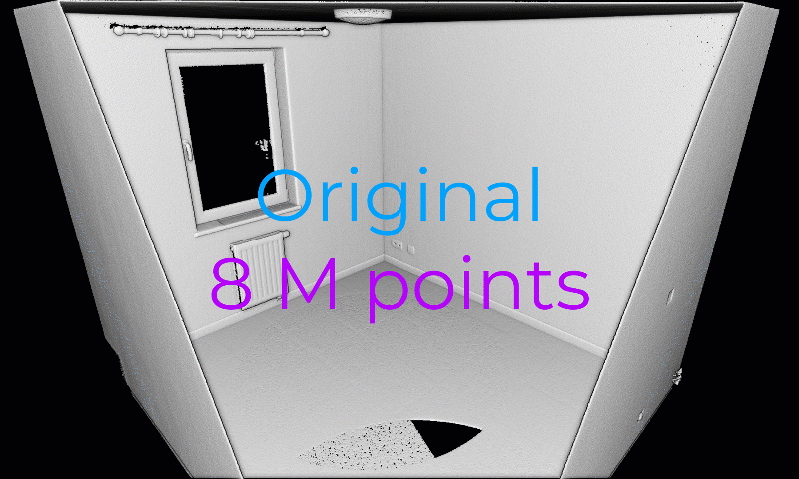
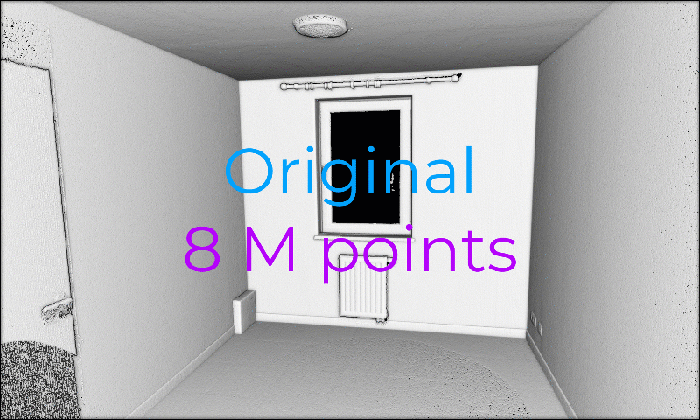
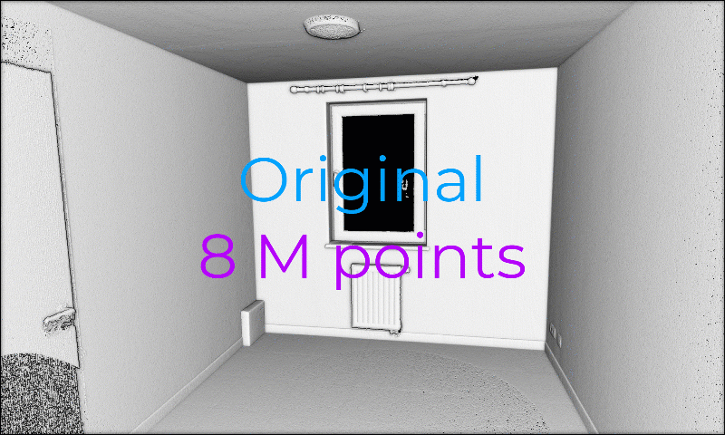
Processing point cloud
Random sampling
Spatial sampling (no point is closer to another point with min distance
Vixel grid structure (more homogeneous spatial dist)

